Slide 1
Programming with B4X
Lesson 8 – Subroutines
Anywhere Software
Feb 2021

Slide 2
Today you will learn
What is a subroutine.
Declaring a Sub
Passing Values
Returning Values from a sub

Slide 3

What is a subroutine.
Subroutine is a sequence of program instructions that performs a specific task, packaged as a unit
The subprogram should only do one task.
Be relatively small and ideally no larger than a screen so that it can be read easily.
Have such name that refers to its function.
Notes:
In computer programming, a subroutine is a sequence of program instructions that performs a specific task, packaged as a unit. This unit can then be used in programs wherever that task should be performed.
Subroutines may be defined within programs, or separately in libraries that can be used by many programs. In different programming languages, a subroutine may be called a routine, subprogram, function, method, or procedure. In general, to create a subprogram, the developer should keep the following in mind:
• The subprogram should only do one task.
• Be relatively small and ideally no larger than a screen so that it can be read easily.
• Have such a name that refers to its function.

Slide 4
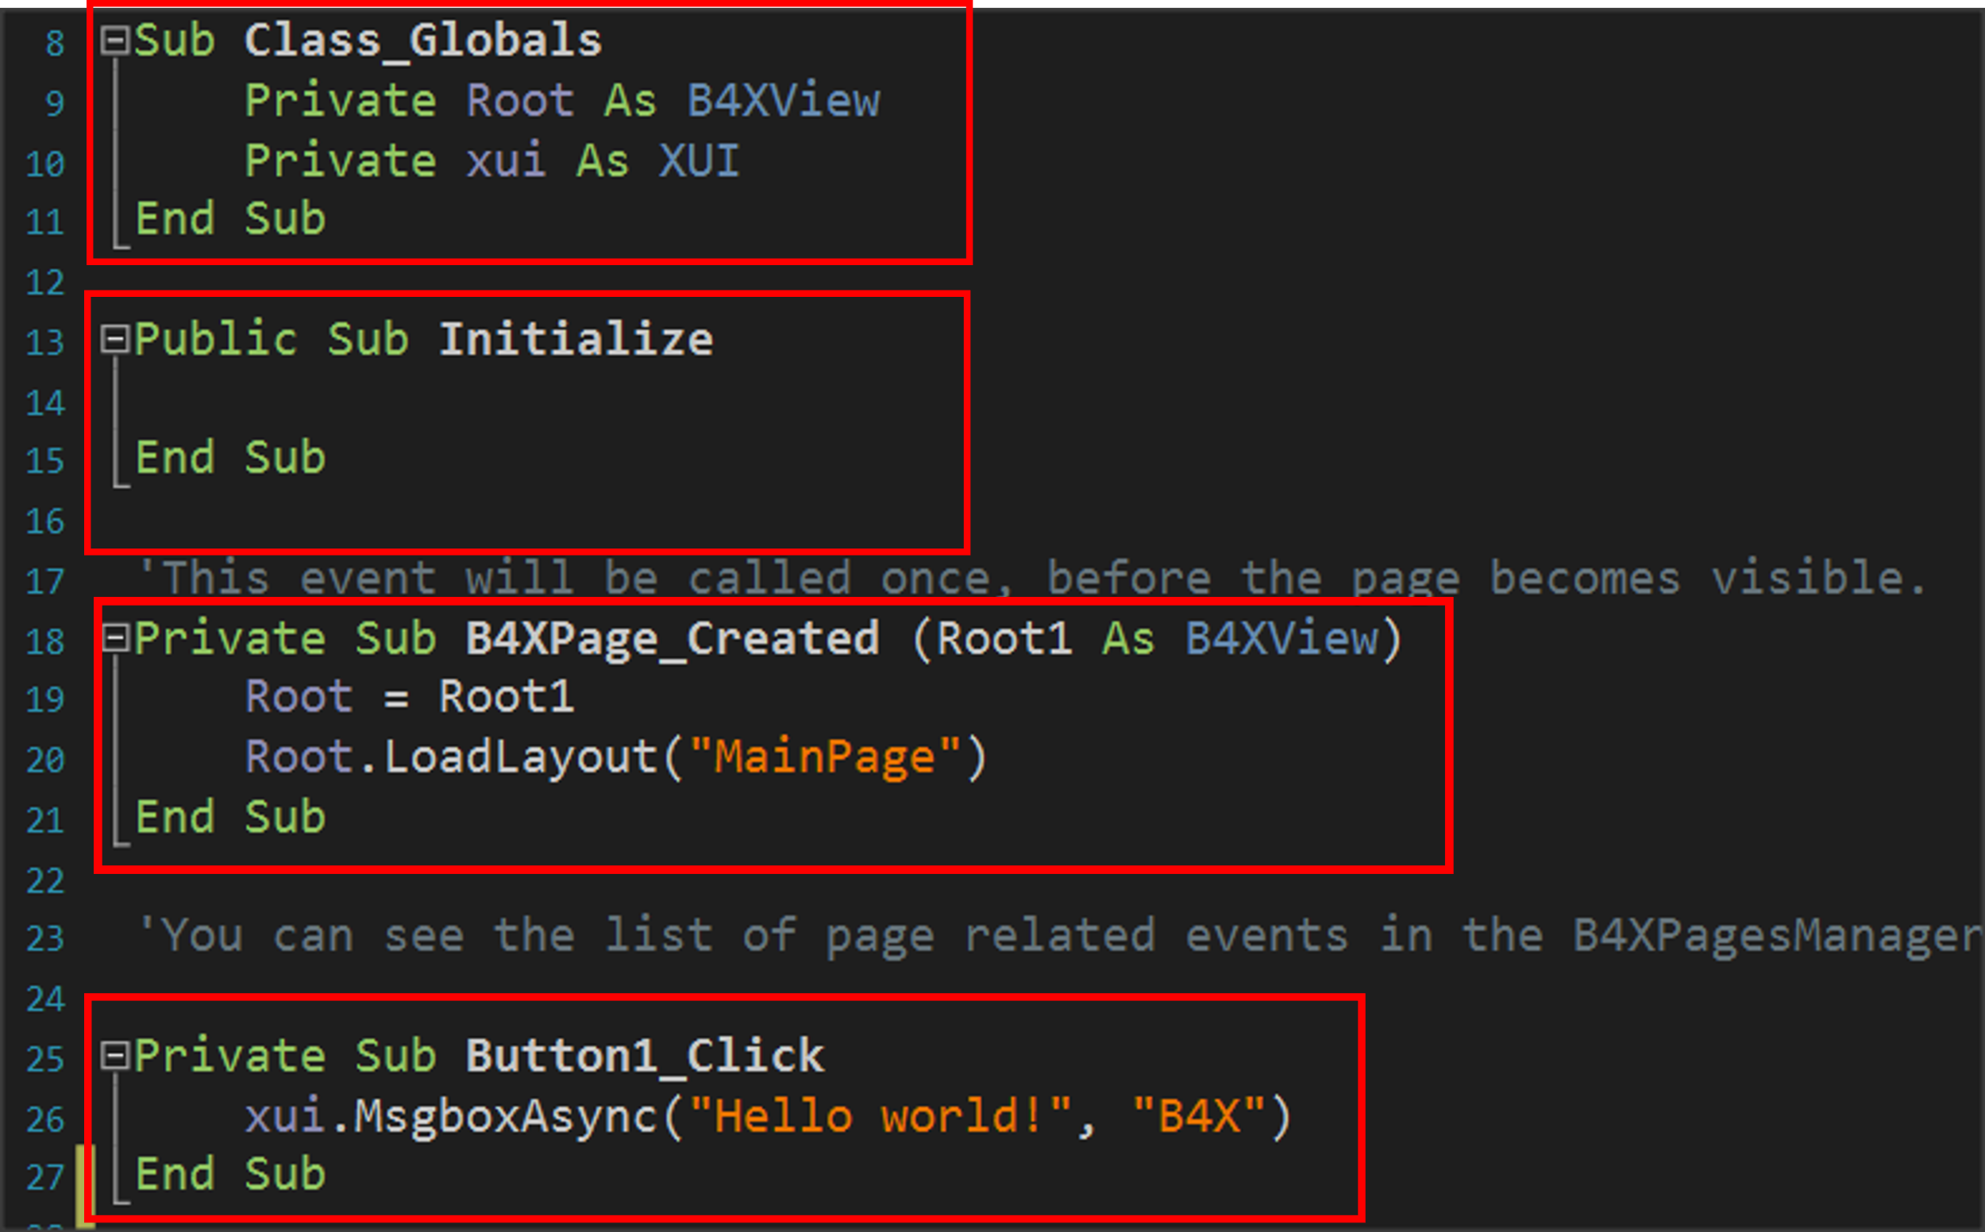
Subprograms
Notes:
You have Button1_Click already encountered subprogram in B4J that the language has prepared. Notice that events like Button1_Click are also a routine to serve the event.

Slide 5
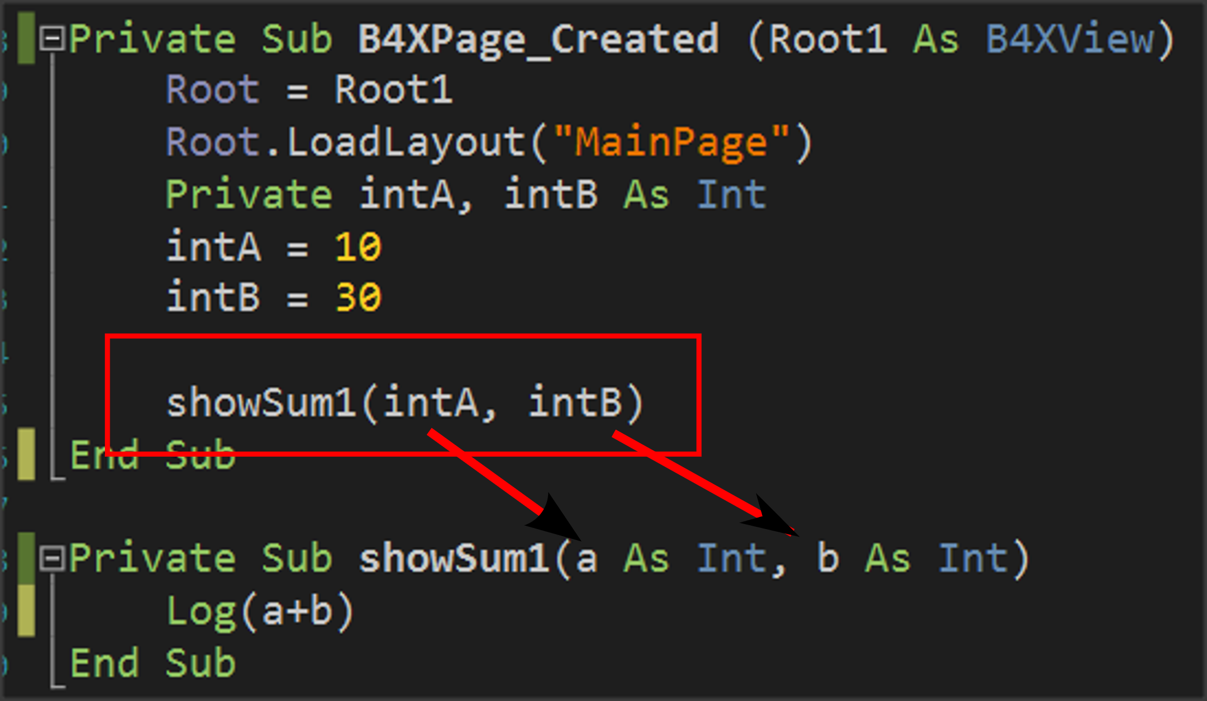
Example 1
Notes:
Suppose a function needs to be performed, such as adding two numbers given by the user. As a program it is very simple and generally does not need a subprogram for such a function. Here we will use a subprogram to understand how it is used and operated.
The two integers intA and intB have been declared in the program, values have been assigned, and then the showSum1 routine is called.
This is done by writing the name of the routine (which the developer decides) and then in parentheses the variables whose values it must know to function.

Slide 6
Create a subroutine
It always begins with Private or Public statement
Then continues with Sub statement which means subroutine
In parentheses, the names of the variables that will receive the data from the call point are indicated.
Notes:
It always starts with the Private statement which means that it is a subprogram that will be known only in the code (B4XmainPage) or Public for the subprogram to be known in other parts of our application.
Notice in the image that this data enters in the order written when calling the routine, i.e. the value of the intA will enter in variable a and the value of the variable intB will enter in variable b.
Variables exchanged between subprograms during their call are called p-rameters.

Slide 7
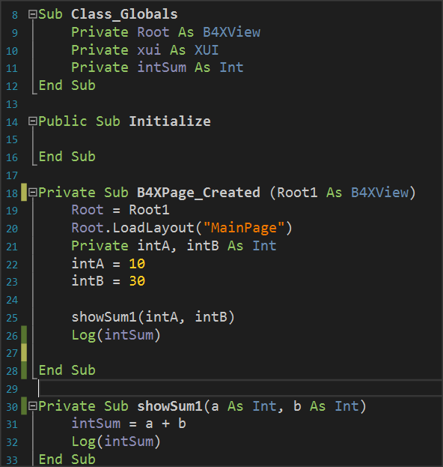
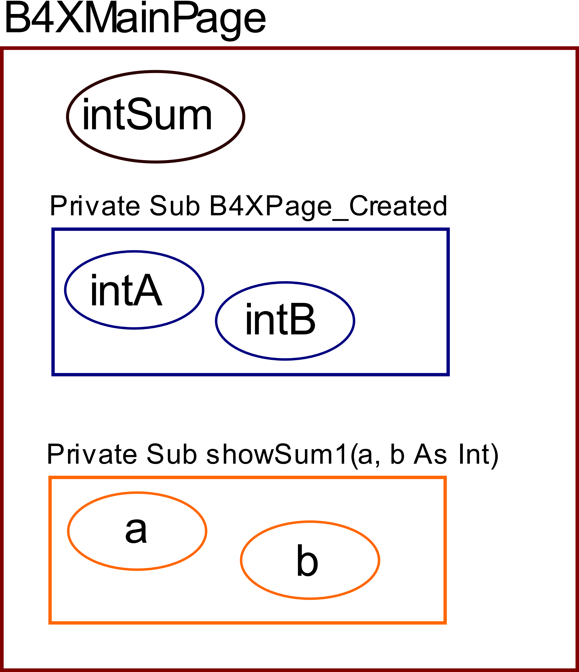
The memory of the subprogram in B4X
Variables declared within Class_Globals are known in all subprograms and are called Global.
The variables declared within the subprograms are called Local and are not known in the rest program.
Notes:
Each subprogram has its own memory space to store their variables. An exception to this rule is the Class_Globals subprogram, whose data is known to all B4XMainPage routines and can be reported to them by name.
From the image code you can notice that the variable intSum is known in both subprograms and is used simply by writing its name. In B4X these variables are displayed in a different color so that the developer can Distinguish easily. On the contrary, variables declared within the remaining variables live only within them and another subprogram cannot use them by name.

Slide 8
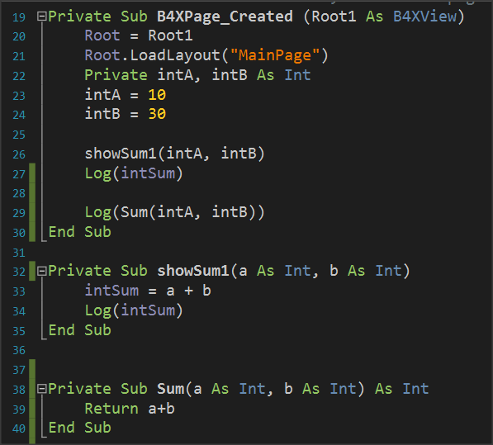
Return a value from a subprogram.
The program must be declared as a variable type.
In addition, the return command must be used within the subprogram to return the calculated value.
Finally, the code that called the subprogram accepts back the value calculated and can use it like any variable.
Notes:
A subprogram can return a value to the code that calls it. This is done through the subprogram name itself as follows:
•The program must be declared as a variable type.
•In addition, the return command must be used within the subprogramm to return the calculated value.
•Finally, the code that called the subprogram accepts back the value cal-culated and can use it like any variable.

Slide 9
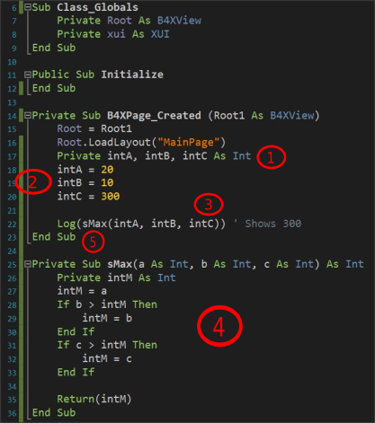
Example 2
Write a subprogram that accepts 3 integer variables and returns the largest
1. Three integer variables (Inta, intB, intC) are declared within subprogram B4XPage_Created.
2. Values are assigned to the three variables.
3. The sMax subprogram is called with parameters the three variables.
4. The subprogram applies the MAX algorithm for the three variables a, b, c and returns the intM value calculated.
5. Finally, the highest value appears on the Log screen.
Notes:
Write a subprogram that accepts 3 integer variables and returns the largest value.
1. Three integer variables (Inta, intB, intC) are declared within subprogram B4XPage_Created.
2. Values are assigned to the three variables.
3. The sMax subprogram is called with parameters the three variables.
4. The subprogram applies the MAX algorithm for the three variables a, b, c and returns the intM value calculated.
5. Finally, the highest value appears on the Log screen.

Slide 10

Remember
We love subprograms because:
It is boring to always write the same code.
It is faster than anyone can type.
It is helping not to repeat the same mistakes. You have done it once!
Cool programmers write subprograms.

Slide 11
Thank you!!!
Photos taken From:
Photo by Markus Spiske on Unsplash

